Slide 1
IndyCar - Resolving latency issues of the message flow and implementing the data persistence layer
SP19-BL-ENGR-E599 – High Performance Big Data Systems
Authors:
Arpit Bansal
Nishant Jain

Slide 2
Introduction
Indy Car Project
Goal is to select the optimal broker service for the IndyCar project to facilitate interaction between different modules
Options: MQTT using ActiveMQ or RabbitMQ
Benchmark the performance and select the optimal one
Implement a data persistence layer using MongoDB to query the race data through log files
Create a Data API for the project which can be imported at any other layer of Indycar application

Slide 3
Related Work
Indy Car Project
ActiveMQ vs RabbitMQ:
- ActiveMQ is faster on message reception (the client sends the message to the broker),
- RabbitMQ is faster on producing messages (the client receiving messages from the broker)
RabbitMQ vs Kafka:
The difference lies in the design decisions made while developing and implementing these solutions.
- RabbitMQ is capable of handling messages in memory, and its queue logic is optimized for empty or nearly-empty queues.
- Kafka is designed aiming at high-throughput and can handle consumers of varying speeds.
Hosting an instance of MongoDB, Schema Designing in MongoDB
Importing data into MongoDB and retrieving results using MongoDB using Java
Creating a Data API in Java
https://ieeexplore.ieee.org/abstract/document/7311982
https://www.researchgate.net/publication/319463829_Kafka_versus_RabbitMQ

Slide 4
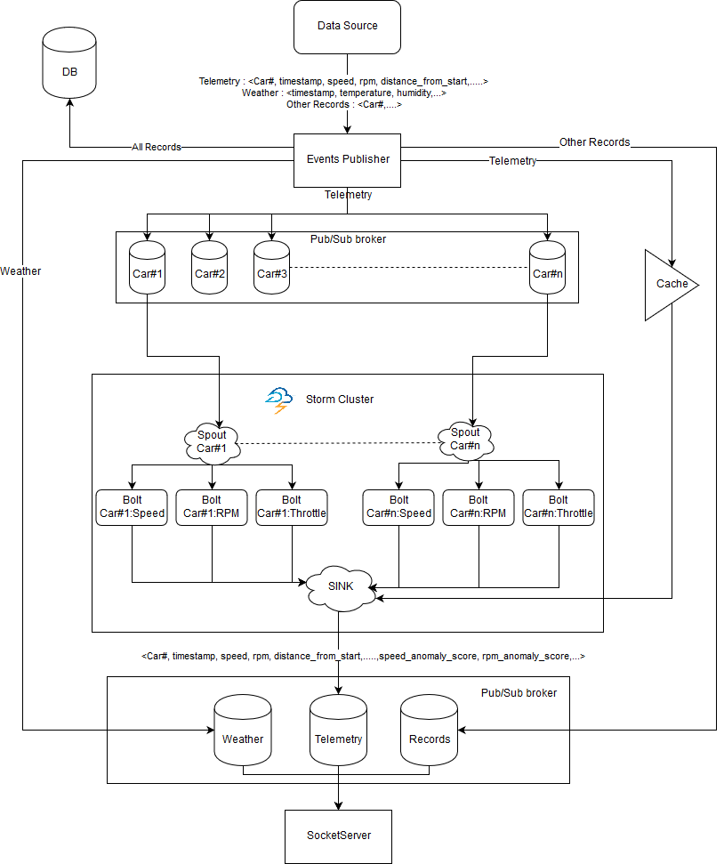
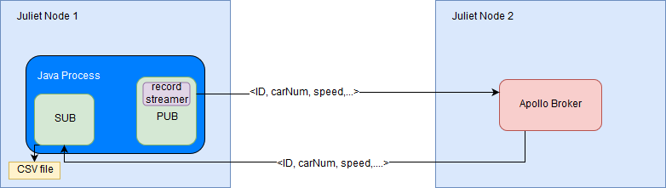
Architecture
Indy Car Project
Fig 1. : MQTT testing
Fig 2. : IndyCar project architecture

Slide 5
Experiment
Indy Car Project
Use Apache Apollo ActiveMQ\RabbitMQ to setup MQTT message broker service on one node
Use the other node as a publisher and subscriber to send and receive data and calculate the round-trip time for the message.
Use log files from previous IndyCar races to test the system
Cases:
Case 1: No. of cars = 1, No. of messages = 50,000
Case 2: No. of cars = 8, No. of messages = 50,000
Case 3: No. of cars = 33, No. of messages = 50,000
Run each case 5 times to get average latency in milliseconds to send and receive each message. Additionally calculate:
Standard Deviation
Standard Error
Min and Max

Slide 6
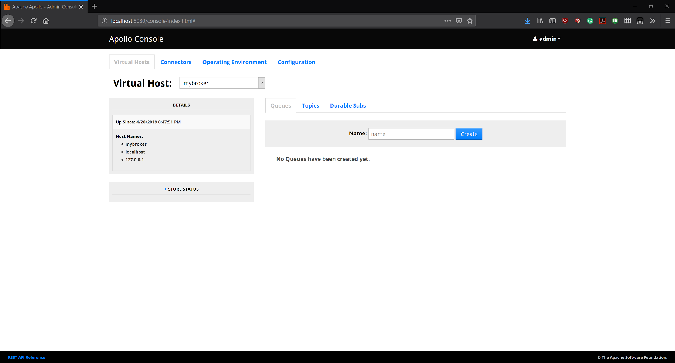
ActiveMQ Client
Indy Car Project

Slide 7
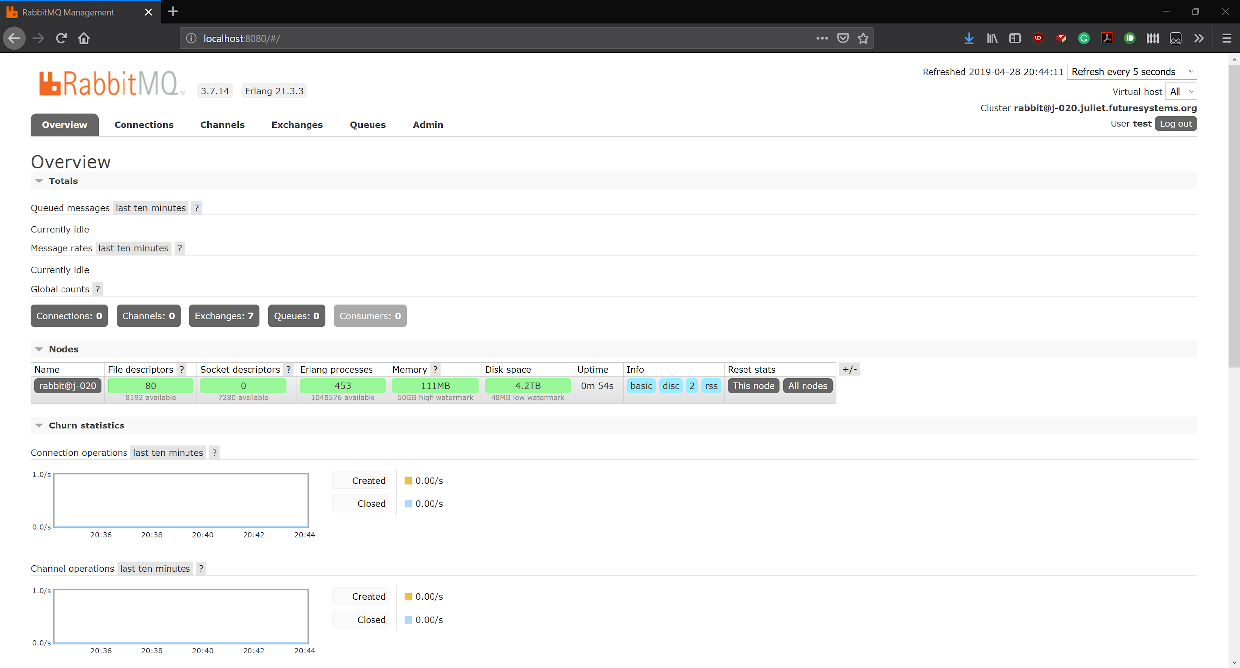
RabbitMQ Client
Indy Car Project

Slide 8
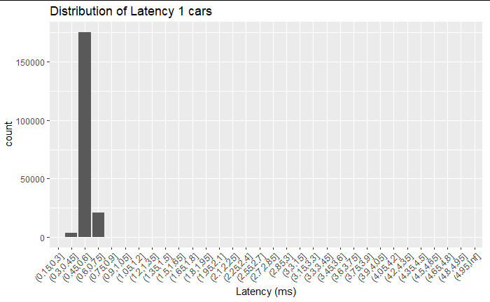
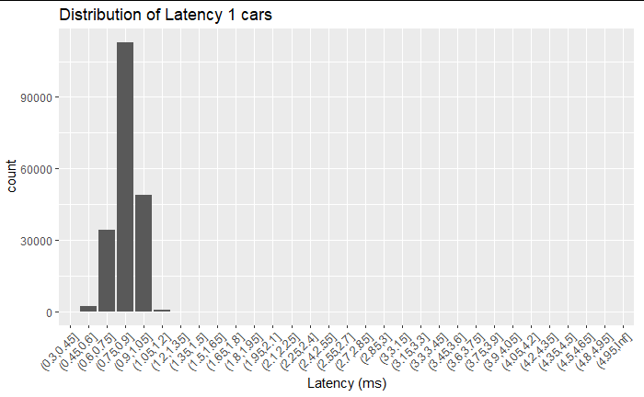
ActiveMQ v\s RabbitMQ Results - For 1 car
Indy Car Project
 | Milliseconds
Mean | 0.56
Std Dev | 0.33
Std error | 0.00
Min | 0.29
Max | 116.41
 | Milliseconds
Mean | 0.83
Std Dev | 0.11
Std error | 0.00
Min | 0.41
Max | 6.27
Statistics

Slide 9
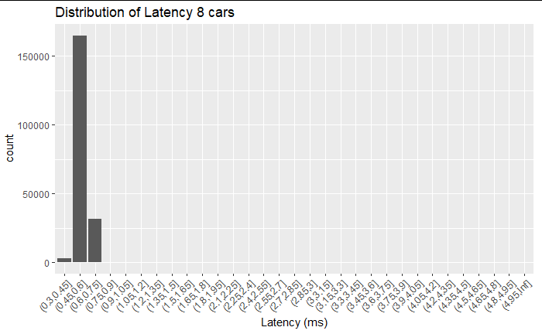
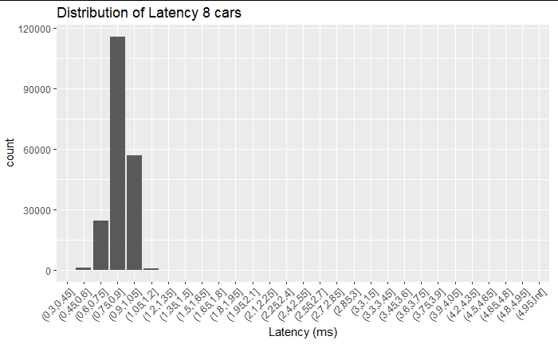
ActiveMQ v\s RabbitMQ Results - For 8 Cars
Indy Car Project
 | Milliseconds
Mean | 0.57
Std Dev | 0.35
Std error | 0.00
Min | 0.31
Max | 87.98
 | Milliseconds
Mean | 0.85
Std Dev | 0.32
Std error | 0.00
Min | 0.43
Max | 100.48
Statistics

Slide 10
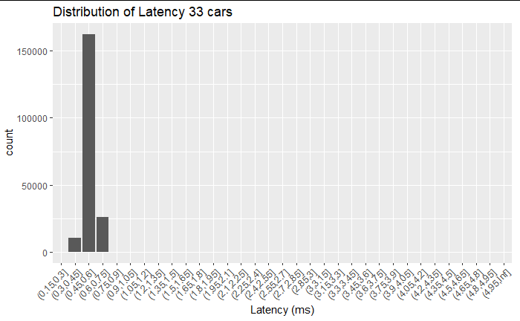
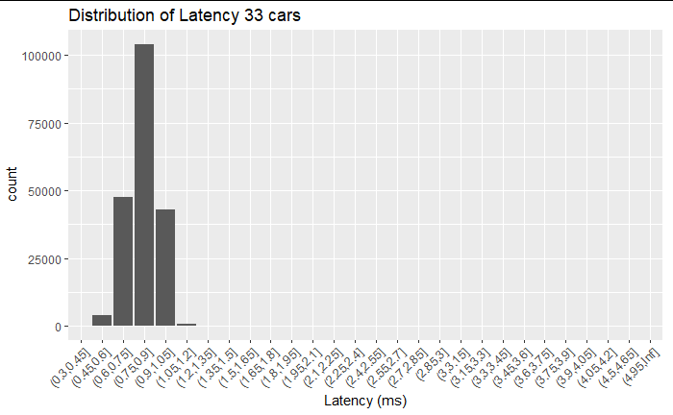
ActiveMQ v\s RabbitMQ Results - For 33 Cars
Indy Car Project
 | Milliseconds
Mean | 0.55
Std Dev | 0.33
Std error | 0.00
Min | 0.19
Max | 82.5
 | Milliseconds
Mean | 0.82
Std Dev | 0.25
Std error | 0.00
Min | 0.41
Max | 71.1
Statistics

Slide 11
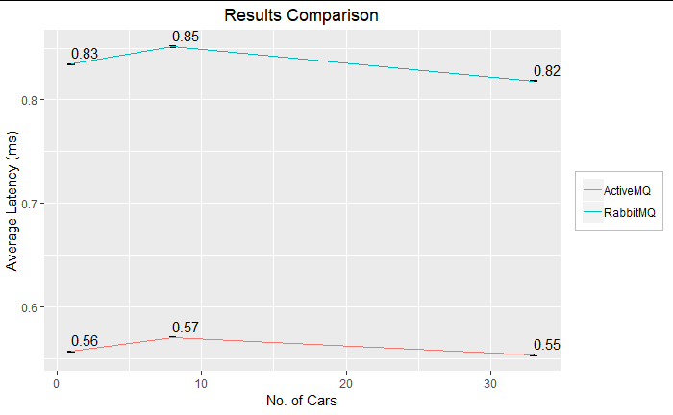
ActiveMQ v\s RabbitMQ Results
Indy Car Project
Comparing the mean values of latency for both the brokers, as well as showing the error bars (not visible due to very low value)

Slide 12
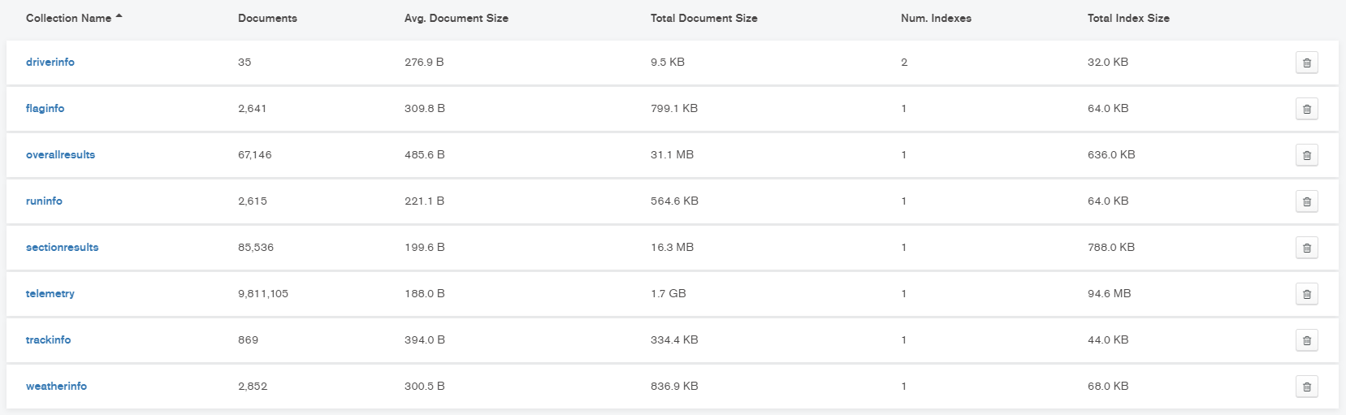
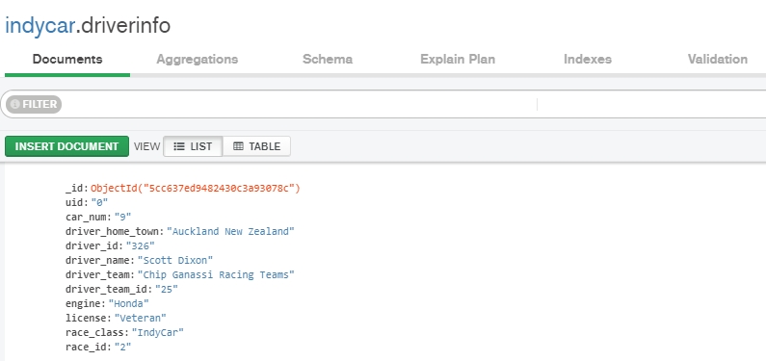
A Snapshot of data in MongoDB
Indy Car Project

Slide 13
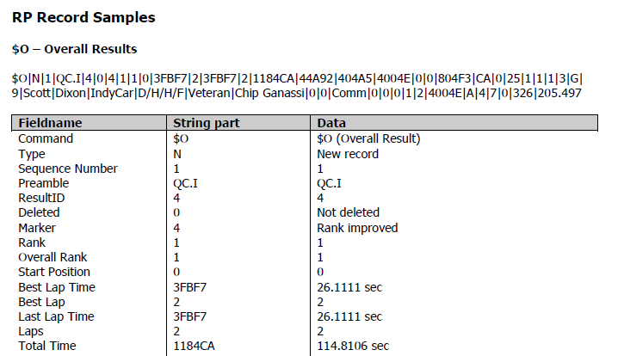
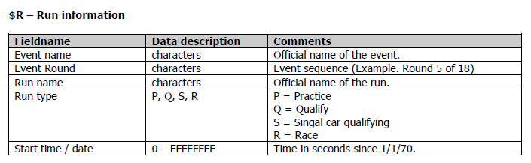
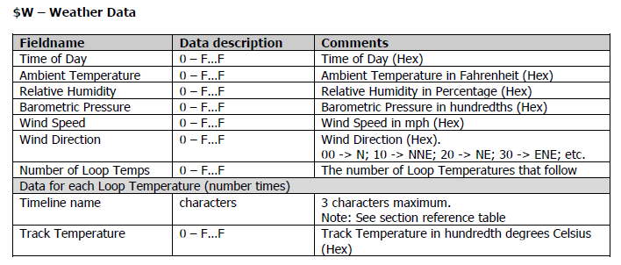
Algorithms and Data Set
Indy Car Project
Used IndyCar log files from 2018 races
Sample Record definition files
Headers processed:
$C – Completed lap results | $E - Entry information
$R – Run information | $T – Track information
$F – Flag information | $P - Telemetry information
$S - Completed section results | $W - Weather information

Slide 14
Data API
Indy Car Project
Drivers
List all the drivers
Search driver by name. (Typing Ca, should return Ed Carpenter, Carl, etc)
Get Set of drivers for race
Get the driver’s profile
Get Lap records and lap section records when driver and race is given.
Races
List all races(just the name and id)
Get all race metadata
Get the ranks of the race
Get a snapshot of a race at given time. (Including speed,rpm, throttle etc of each car at the given time.
Get all the flags of a given race.
Track
List all the tracks
Get all the information of a track, when track name or id is given.

Slide 15
Challenges Faced
Indy Car Project
Understanding current architecture of the IndyCar project and the log record structure.
Schema Designing in MongoDB
Configuration issues while setting up ActiveMQ, RabbitMQ and MongoDB
Conversion from Hexa values present in log records to Decimal
Integration of our code into existing IndyCar components.

Slide 16
Learnings
Indy Car Project
Research done on the different message brokers available
Insights into how Pub\Sub architecture works and how message brokers help (when compared to monolithic architecture)
Understanding design decisions made while developing and implementing ActiveMQ/RabbitMQ and MongoDB
Writing Java code for data insertion and retrieval from a NoSQL database

Slide 17
Future Work
Indy Car Project
Integrate the new broker with the existing IndyCar architecture
Comparison with other popular brokers like Kafka
Make required changes to make it work with streaming data (Currently reading from a folder)
Make configuration changes in the server configuration for MongoDB to be able to accomodate more requests
Enhance the functionality of the Data API

Slide 18
Conclusion
IndyCar Project
ActiveMQ provides lower latency times
RabbitMQ is more robust with less variation in latency, and lower maximum latency
We propose RabbitMQ because of its robustness, as well as it needs to feed data to MongoDB which is a slow consumer, hence a bit higher latency times won’t effect, instead would be better in this case
And latency of 0.8 ms is still extremely good

